Slide 1
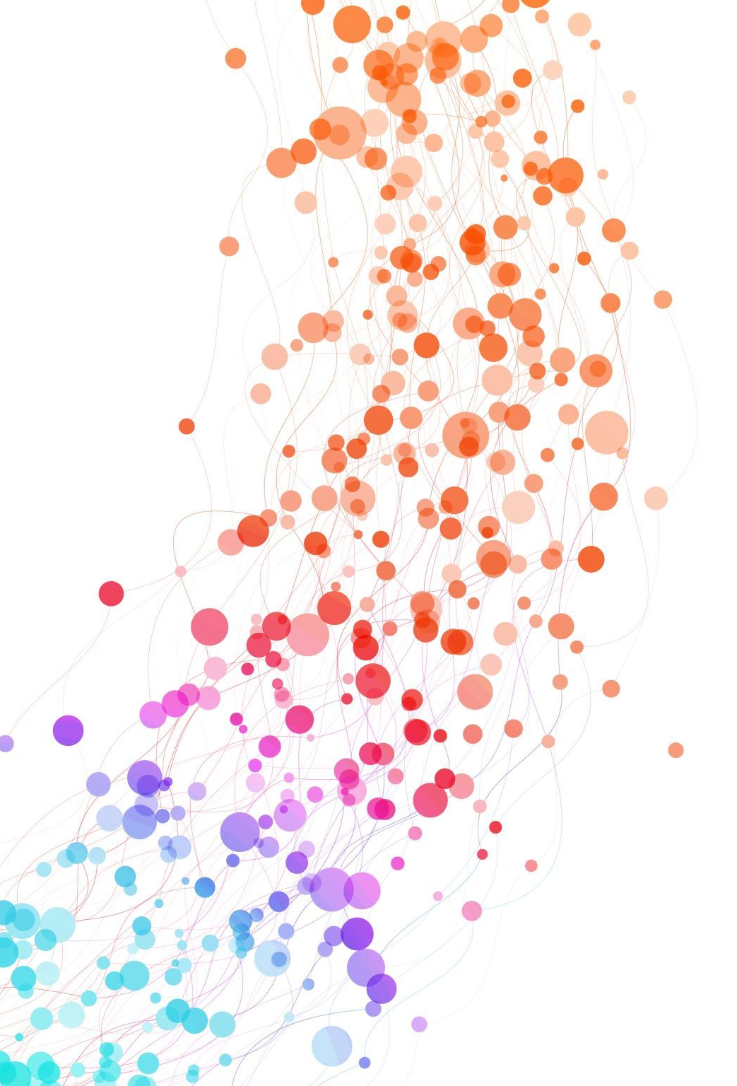
problem framing and definition
Master 1 SDIA
Prof LAYEB Abdesslem
University of Constantine 2, Algeria

Slide 2

”If I had an hour to solve a problem, I’d spend 55 minutes thinking about the problem and 5 minutes thinkingabout solutions.”
Albert Einstein

Slide 3

What is a problem framing?
Problem framing is a crucial stage in design thinking and problem-solving that involves analyzing, understanding, and defining the problem in a comprehensive and meaningful way.
It serves as the foundation for developing effective solutions by ensuring everyone involved has a shared understanding of the issue at hand.

Slide 4

key aspects of problem framing:
Exploration and Discovery:
It's an exploratory phase where you gather information through research, user interviews, observation, and other methods.
This phase involves identifying different aspects of the problem, considering the context and background, and exploring various potential causes and contributing factors.
Defining the Scope:
Problem framing helps us define the boundaries of the problem, ensuring we are not addressing irrelevant aspects or trying to solve everything at once.
By defining the scope, we can focus your efforts on the most critical aspects of the issue and develop more targeted solutions.
Laying the Groundwork:
The outcome of problem framing is a deeper understanding of the problem and its various facets.
This understanding lays the groundwork for creating a clear and concise problem definition, which is a crucial step in guiding the design thinking process towards effective solutions.

Slide 5

key aspects of problem framing
See the bigger picture: Gain a comprehensive understanding of the problem and its context.
Identify root causes: Uncover the underlying factors contributing to the issue.
Challenge assumptions: Question existing beliefs and consider alternative perspectives.
Prepare for problem definition: Set the stage for crafting a clear and actionable problem statement.

Slide 6
What is a problem definition statement?
A problem definition statement is a clear, concise description of an issue or unsatisfactory situation that needs to be addressed.
It defines the problem specifically and clearly.
It provides relevant context and background, so readers understand why the problem matters and its significance.
It focuses on outcomes or impacts rather than assigning blame.
It uses quantitative and qualitative evidence like data, examples, stories to demonstrate the scope and scale of the problem.
It considers multiple stakeholders and perspectives rather than just one view.
It does not propose a solution. The goal is to simply define the core problem, not prescribe how to fix it.
It establishes a sense of urgency for addressing the problem by outlining risks and consequences of inaction.

Slide 7

Example of a problem definition statement:
"Students struggle to find reliable and engaging learning resources online, leading to frustration and decreased motivation. How might we design a platform that curates high-quality educational content and personalizes the learning experience for each student?"
This statement clearly identifies
the user group (students),
their problem (finding reliable resources
the consequences (frustration and decreased motivation), and
the desired outcome (a personalized learning platform).

Slide 8

Components of a Problem Statement
Context:
Describe the Context: Provide background information on the overall situation or environment in which the problem exists. This helps in understanding the larger context.
Problem Definition:
Clearly State the Problem: Define the problem in clear and specific terms. Avoid vague or broad statements. Be precise about what needs to be solved.
Scope:
Specify the Scope: Clearly describe what is within the scope of the problem and what is outside of it. Define the boundaries to avoid confusion.
Impact and Significance:
Highlight the Importance: Explain why solving this problem is crucial. Describe the impact it has on stakeholders, processes, or outcomes.

Slide 9
Components of a Problem Statement:
Stakeholders:
Identify Key Stakeholders: Specify individuals, groups, or entities that are directly affected by the problem. This helps in understanding different perspectives.
Objectives:
Define Specific Objectives: Clearly outline what you aim to achieve by addressing the problem. Formulate objectives that are measurable and aligned with overall goals.
Constraints and Assumptions:
List Constraints: Identify any limitations or constraints that might affect the problem-solving process.
State Assumptions: Clearly state any assumptions made during the definition. Acknowledge areas where information might be incomplete.

Slide 10
Problem framing VS Problem definition
Problem framing like exploring a new city. You wander the streets, gather information, and get a general sense of layout and different districts.
Problem definition is like choosing a specific destination in that city. You've narrowed down our focus and know exactly where we want to go, making it easier to plan our route and navigate towards our goal.
Problem framing: Exploration and understanding the problem in its entirety.
Problem definition: Clear and concise statement outlining the core issue to be addressed.

Slide 11
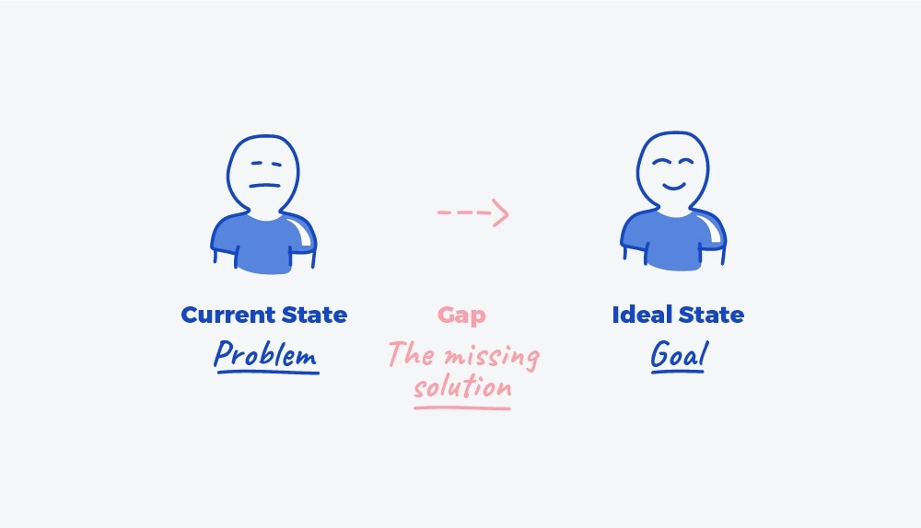
Problem framing VS Problem definition
The purpose of problem framing is, often, to produce a problem statement. A problem statement is a concise statement that summarises the current state (problem), the ideal state (goal), and the gap between them.

Slide 12

Framing the Problem in design thinking
Reframing the problem is a crucial step in design thinking, allowing us to approach the challenge from new perspectives and unlock innovative solutions.
It involves shifting our eyes to see the problem in a different light
Rise creativity: By challenging assumptions and exploring different viewpoints, we can generate new ideas and solutions that may not have been considered initially.
Uncovers hidden insights: Reframing can help we identify underlying causes and deeper complexities of the problem, leading to more effective solutions.
Expands the scope of possibilities: By considering alternative perspectives, we may discover entirely new directions for addressing the problem, potentially leading to more impactful solutions.

Slide 13
Effective Techniques for Reframing
Ask "why" questions: Drill down to the root cause of the problem by repeatedly asking "why" this happens.
Challenge assumptions: Question the underlying beliefs and limitations associated with the problem.
Consider alternative perspectives: Look at the problem from the viewpoint of different stakeholders or through unconventional lenses.
Explore analogies and metaphors: Draw inspiration from similar situations or unrelated fields to spark new ideas.
Reverse the problem: Flip the problem on its head and consider the opposite scenario to gain a fresh perspective.

Slide 14
Example of Framing the problem
Initial problem: Students struggle to find reliable and engaging learning resources online, leading to frustration and decreased motivation.
Reframed problem: How might we create a learning experience that is personalized, interactive, and enjoyable, motivating students to actively engage with the material and take ownership of their learning journey?
By reframing the problem, the focus shifts from simply finding resources to creating a holistic learning experience that addresses the underlying causes of student frustration and disengagement. This opens up possibilities for solutions beyond traditional online resource platforms.
Remember: Reframing is an iterative process. Experiment with different techniques and encourage diverse perspectives to maximize the potential for uncovering innovative and impactful solutions.

Slide 15
Framing Techniques for Innovative Solutions
The Power of "Why":
Ask "why" repeatedly: This simple yet powerful technique helps we drill down to the root cause of the problem. Don't settle for the initial answer; keep asking "why" until we reach the fundamental reason behind the issue.
Example:
Initial problem: People are not using our public transportation system.
Why? Because it's slow and inconvenient.
Why is it slow and inconvenient? Because there are long wait times and unreliable schedules.
Why are there long wait times and unreliable schedules? Because there aren't enough buses and the infrastructure needs improvement.
By asking "why" repeatedly, we uncover the underlying factors contributing to the problem, allowing we to address them more effectively.

Slide 16
Reframing Techniques for Innovative Solutions
Exploring Diverse Perspectives:
Step outside our shoes: Look at the problem from the viewpoint of different stakeholders involved. Consider the perspectives of users, employees, competitors, or even seemingly unrelated parties.
Example:
Problem: Students struggle to stay engaged in online lectures.
Teacher's perspective: Lectures are well-structured and informative.
Student's perspective: Lectures are long and monotonous, lacking interactivity.
Technical support: The online platform might have usability issues.

Slide 17
Framing Techniques for Innovative Solutions
Identifying the Root Cause:
Go beyond the symptoms: Don't just focus on the surface-level manifestations of the problem. Dig deeper to identify the fundamental cause that's driving the issue.
Example:
Problem: Customers are canceling their subscriptions to our service.
Root cause: Customers feel the service is overpriced and doesn't offer enough value compared to competitors.
By identifying the root cause, we can address the problem at its core, leading to more sustainable and impactful solutions.

Slide 18

Case study : Triage system for emergency department
Initial problem: Long wait times, crowded waiting rooms, and high levels of stress for patients and staff in emergency rooms.
Reframing: The project reframed the problem as designing a system that improves patient flow, reduces stress, and fosters communication between patients and healthcare providers.
Solution: Implementing a triage system to categorize patients based on urgency, providing real-time updates on wait times, and creating designated waiting areas for different patient needs.

Slide 19

Techniques for Identifying Problem Statements:
Diverge and Converge Brainstorming:
Diverge: Individually or as a group, brainstorm all the potential problems, challenges, or pain points we observe. Write down everything without judgment or censorship.
Converge: Once we have a comprehensive list, come together to discuss, analyze, and categorize the identified issues. Look for patterns, recurring themes, and connections between different problems. Gradually refine the scope and identify the most pressing or impactful issue to focus on.

Slide 20

Techniques for Identifying Problem Statements:
5W Problem Framing Canvas:
This method uses a visual framework to explore the problem from different angles. Create a canvas divided into sections for Who, What, When, Where, and Why.
Fill each section with information related to the problem:
Who: Who is affected by the problem?
What: What specifically is the problem?
When: When and how often does the problem occur?
Where: Where does the problem occur?
Why: Why is this a problem? What are the consequences?
By systematically addressing these questions, we gain a deeper understanding of the problem and its context, facilitating a more informed framing of the statement.

Slide 21
Example
1. What:
Problem Statement: Prolonged patient waiting times in the emergency department triage system.
2. Why:
Root Causes:
Insufficient staffing during peak hours. Inefficient triage processes leading to delays in assessment. Limited use of technology for streamlined data entry and retrieval.
3. Where:
Scope and Context:
Occurs within the emergency department triage area. Impacts patients seeking urgent medical attention.
4. When:
Timeline and Occurrence:
Peak times during evenings and weekends. Consistent occurrence leading to patient dissatisfaction.
5. Who:
Stakeholders and Impact:
Directly impacts patients in need of urgent care. Staff members dealing with increased workload and stress. Hospital administration concerned with patient satisfaction and quality of care.

Slide 22

Techniques for Identifying Problem Statements:
Empathy Mapping:
This technique helps we step into the shoes of our target users and understand their experiences, frustrations, and needs related to the problem.
Create a canvas divided into sections like Says, Does, Thinks & Feels, and Pain Points.
Gather information through user research, interviews, and observations to populate each section.
By understanding the user's perspective, we can frame the problem statement in a way that resonates with their needs and challenges.

Slide 23

Techniques for Identifying Problem Statement
The 5 Whys:
This technique involves repeatedly asking "why" to uncover the root cause of the problem.
Start with the initial problem statement and ask "why" does this happen?
Continue asking "why" to each subsequent answer, drilling down deeper into the underlying factors.
By identifying the root cause, we can frame the problem statement more precisely and address its core issue.

Slide 24
Example 5 why Problem: A significant increase in the number of abandoned shopping carts on an e-commerce website.
1. Why did the number of abandoned shopping carts increase?
Answer: Users are reaching the checkout page but not completing the purchase.
2. Why are users not completing the purchase on the checkout page?
Answer: Users are encountering unexpected shipping costs during the checkout process.
3. Why are there unexpected shipping costs during the checkout process?
Answer: The e-commerce website recently implemented a new shipping fee policy for certain regions.
4. Why was a new shipping fee policy implemented without proper communication?
Answer: The decision to implement the new policy was made by the finance team to address increased shipping costs, but there was no communication plan to inform users about the changes.
5. Why was there no communication plan to inform users about the new shipping fee policy?
Answer: The finance team did not collaborate with the marketing and communication teams when implementing the new policy, leading to a lack of coordination in communicating the changes to users.

Slide 25
Techniques for Identifying Problem Statement
How Might We..." (HMW) Brainstorming:
This technique encourages creative problem-solving by reframing the problem into actionable questions.
Start with the problem statement and rephrase it as a question beginning with "How might we..." followed by a verb that describes the desired outcome.
Brainstorm as many "HMW" questions as possible, exploring different approaches and solutions.
This process helps generate diverse perspectives and spark innovative ideas for addressing the problem.

Slide 26

Example of "How Might We..." (HMW): Emergency Dept.,
Problem Statement:
Long waiting times in the emergency department triage system.
"How Might We..." Questions:
How might we reduce waiting times for patients in the emergency department?
How might we improve the efficiency of the triage process during peak hours?
How might we leverage technology to streamline patient assessments in the triage system?
How might we enhance communication and coordination between triage staff and other departments?
How might we provide a more comfortable and informative experience for patients during the triage process?

Slide 27
Elaborating Effective Problem Statements
1. User-Centricity:
Focus on the user: The problem statement should revolve around the needs, challenges, and frustrations faced by our target users.
Emphasize user impact: Clearly articulate the negative consequences users experience due to the problem, highlighting its significance.
2. Clarity and Specificity:
Avoid ambiguity: Use clear and concise language that unambiguously defines the issue.
Define the scope: Clearly outline the boundaries of the problem to avoid addressing irrelevant aspects.
Quantify when possible: If applicable, use data or metrics to quantify the extent of the problem and its impact.
3. Actionable Framing:
Focus on the "how":phrase it as a question that begins with "How might we..." followed by a desired outcome.
Spark creativity: This format encourages exploring different solutions and fostering innovative thinking.
4. Evidence and Data:
Support our claims: Back up our problem statement with data, research findings, or user quotes to strengthen its credibility.
Demonstrate the need: show the importance of addressing the problem and the potential benefits of finding solutions.
5. Iteration and Refinement:
Consider multiple perspectives: Gather feedback from diverse stakeholders to refine the problem statement.
Be open to adaptation: As we gather more information and insights, be prepared to revisit and refine the statement.

